Slide 1

Zen Garden
PYTHON 禅意花园
Beautiful is better than ugly. Complex is better than complicated. Flat is better than nested. Sparse is better than dense. Readability counts. Special cases aren't special enough to break the rules. Although practicality beats purity.Errors should never pass silently. Unless explicitly silenced. In the face of ambiguity, refuse the temptation to guess. There should be one-- and preferably only one --obvious way to do it. Although that way may not be obvious at first unless you're Dutch.Now is better than never. Although never is often better than right now.If the implementation is hard to explain, it's a bad idea. If the implementation is easy to explain, it may be a good idea. Namespaces are one honking great idea -- let's do more of those!
CT:倪旭春

Slide 2
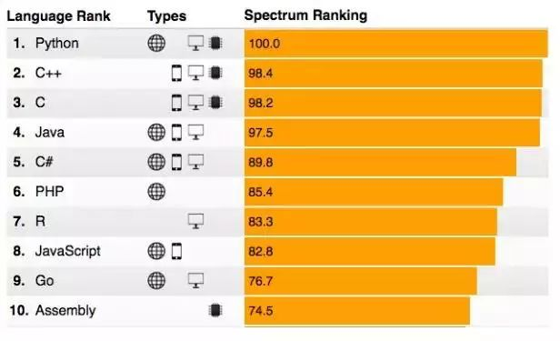

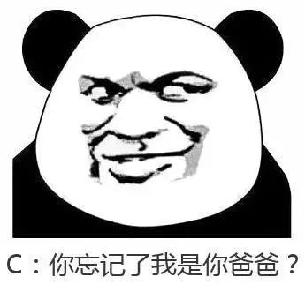
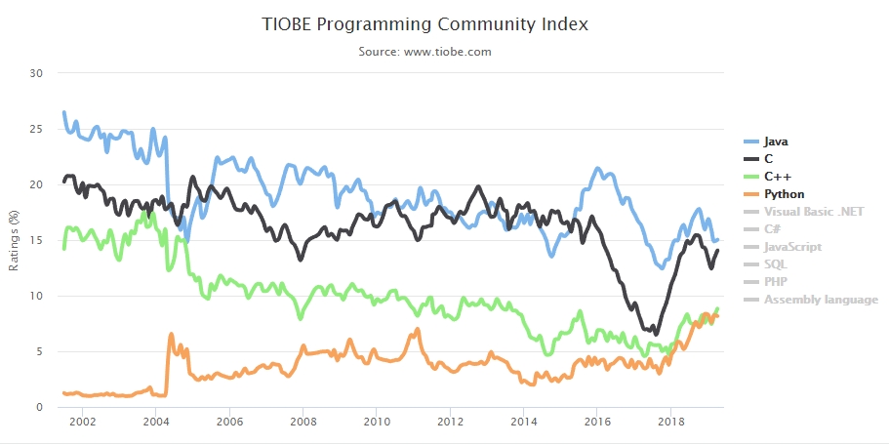
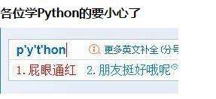
PYTHON语言排名

Slide 3

目 录
构建
fundamental
CONTENTS
独特语法
UNIQUE SUMMARY
风格化
PYTHON STYLE
应用
DEMOSTRATION

Slide 4
01
构建
FUNDAMENTAL
Python流行原因

Slide 5
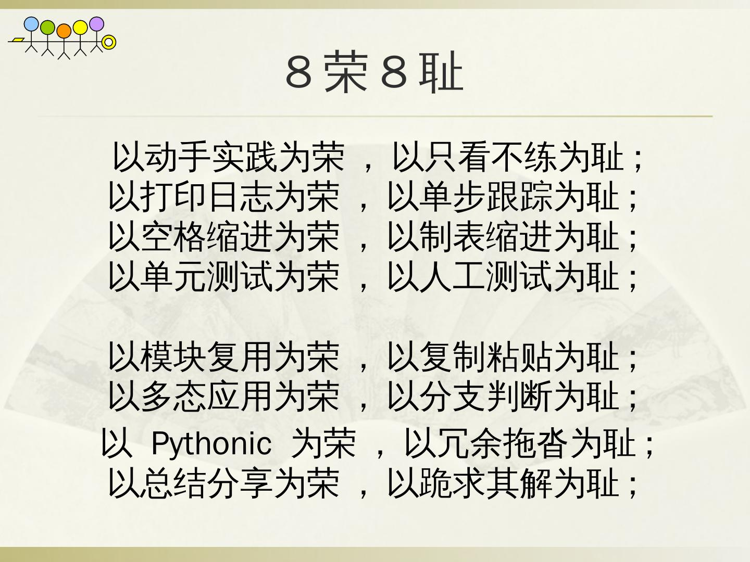
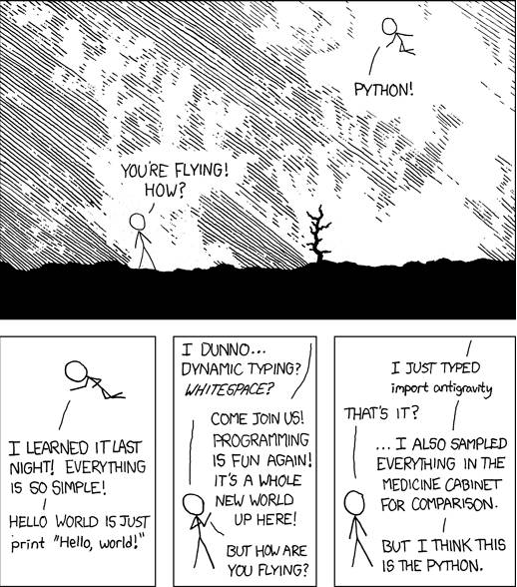

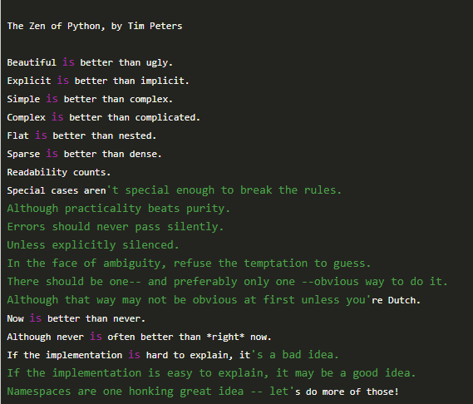



年度工作概述
CLICK TO ADD CAPTION TEXT

Slide 6




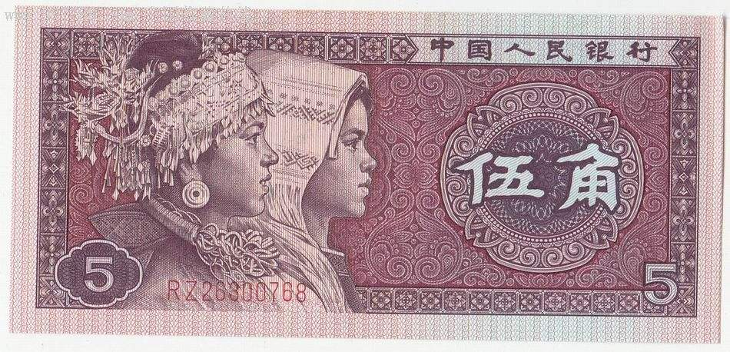

Python流行的原因
请替换文字内容
1
Please replace text, click add relevant headline, modify the text content, also can copy your content to this directly.。
简单
2
简单
60%
80%
简单易学
快速开发
Please replace text, click add relevant headline, modify the text content, also can copy your content to this directly.
Please replace text, click add relevant headline, modify the text content, also can copy your content to this directly.
3
简单
93%
55%
4
简单
脚本语言
三方库 AI
Please replace text, click add relevant headline, modify the text content, also can copy your content to this directly.
Please replace text, click add relevant headline, modify the text content, also can copy your content to this directly.

Slide 7
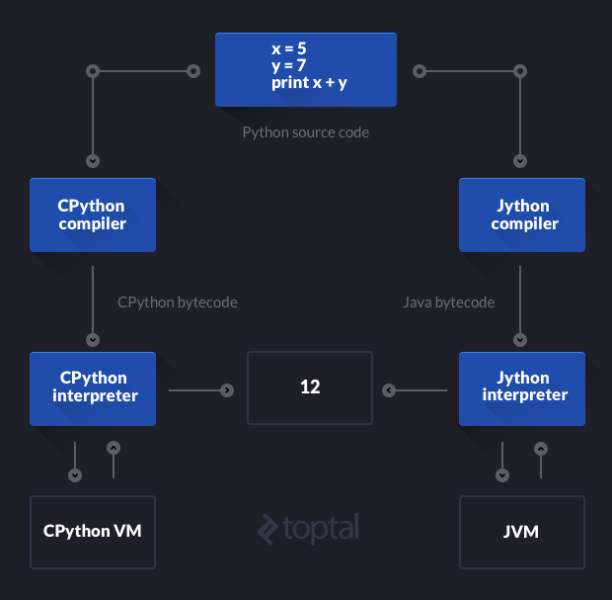
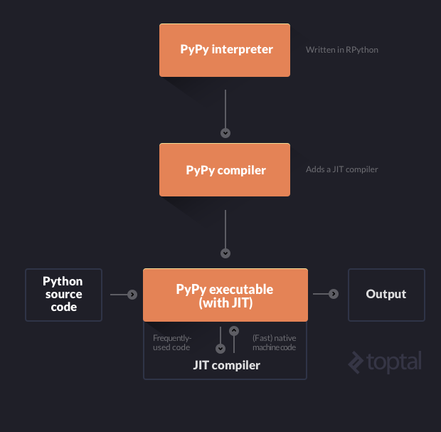
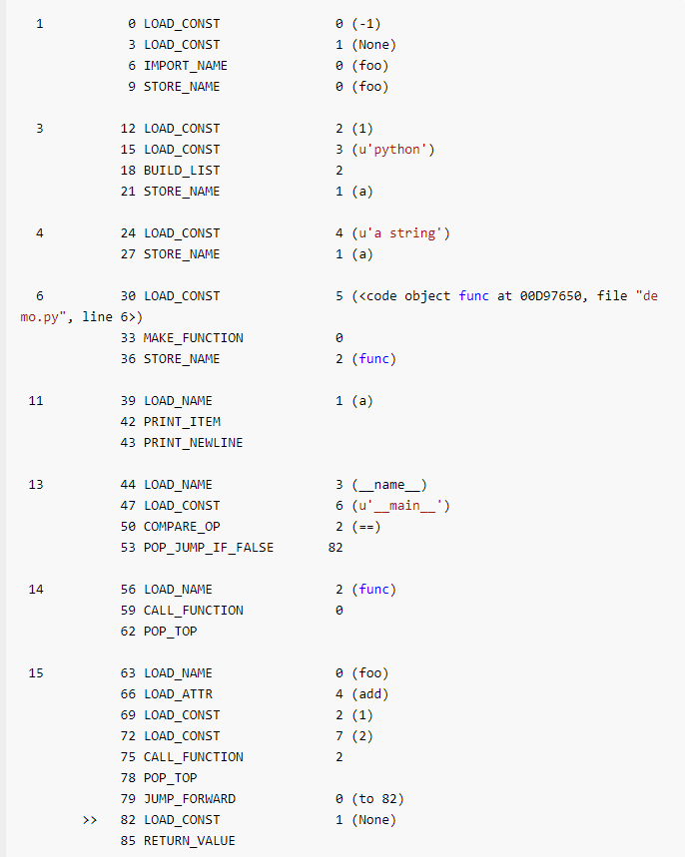
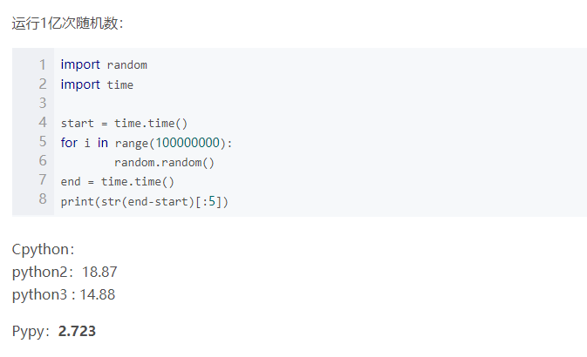
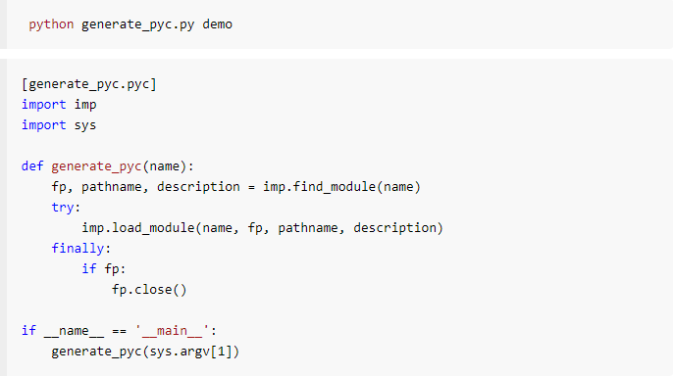
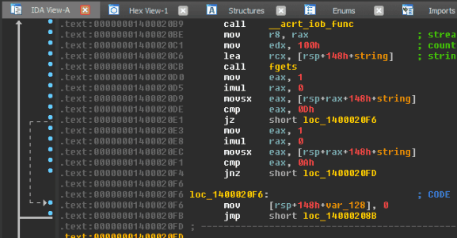
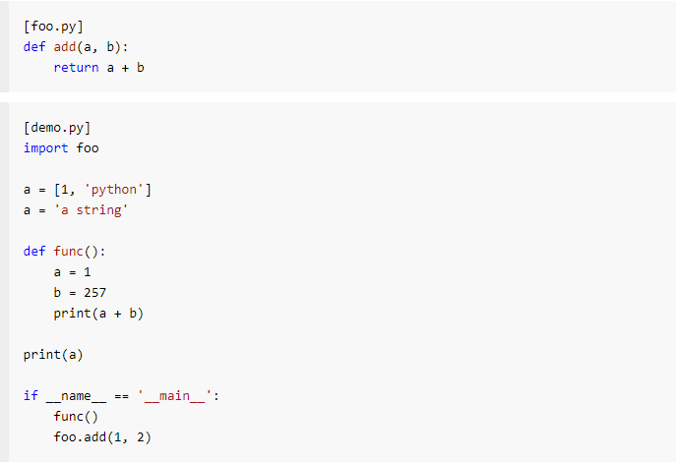
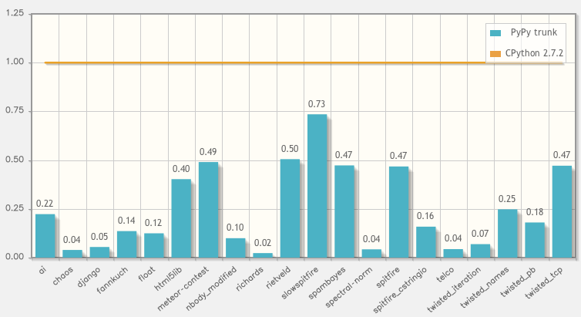
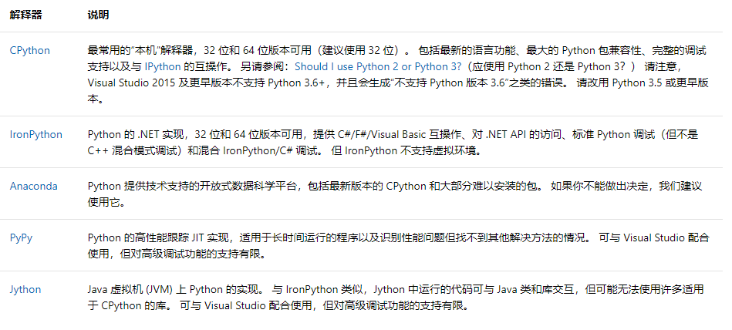
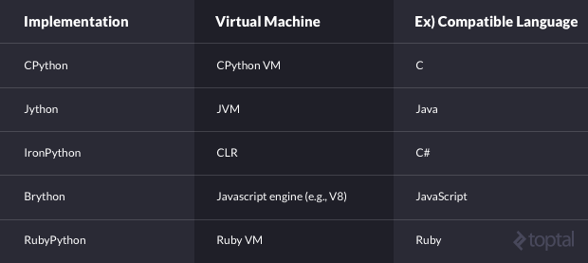
PYTHON解释器
CPython
PyPy
丰富的C类库支持.。
JIT支持，运算高效

Slide 8
04
年度工作概述
对象引用
Please replace text, click add relevant headline, modify the text content, also can copy your content to this directly.
01
CLICK TO ADD CAPTION TEXT
04
yield Please replace text, click add relevant headline, modify the text content, also can copy your content to this directly.
内置方法 Please replace text, click add relevant headline, modify the text content, also can copy your content to this directly.
01
04
列表推导式 Please replace text, click add relevant headline, modify the text content, also can copy your content to this directly.
缩进 Please replace text, click add relevant headline, modify the text content, also can copy your content to this directly.
02
05
lamba Please replace text, click add relevant headline, modify the text content, also can copy your content to this directly.
分片 Please replace text, click add relevant headline, modify the text content, also can copy your content to this directly.
03
06
filter Please replace text, click add relevant headline, modify the text content, also can copy your content to this directly.
索引遍历 Please replace text, click add relevant headline, modify the text content, also can copy your content to this directly.
06
06
类的使用 Please replace text, click add relevant headline, modify the text content, also can copy your content to this directly.
数据结构 Please replace text, click add relevant headline, modify the text content, also can copy your content to this directly.

Slide 9
年度工作概述
CLICK TO ADD CAPTION TEXT
请替换文字内容
Please replace text, click add relevant headline, modify the text content, also can copy your content to this directly.。
请替换文字内容
Please replace text, click add relevant headline, modify the text content, also can copy your content to this directly.。
请替换文字内容
Please replace text, click add relevant headline, modify the text content, also can copy your content to this directly.。

Slide 10
年度工作概述
CLICK TO ADD CAPTION TEXT
文字内容
请替换文字内容
文字内容
Please replace text, click add relevant headline, modify the text content, also can copy your content to this directly.
请替换文字内容
Please replace text, click add relevant headline, modify the text content, also can copy your content to this directly.
请替换文字内容
Please replace text, click add relevant headline, modify the text content, also can copy your content to this directly.
文字内容
文字内容
请替换文字内容
Please replace text, click add relevant headline, modify the text content, also can copy your content to this directly.

Slide 11
02
工作完成情况ANNUAL WORK SUMMARY
添加相关标题文字
添加相关标题文字
添加相关标题文字
添加相关标题文字

Slide 12


年度工作概述
CLICK TO ADD CAPTION TEXT
请替换文字内容
添加相关标题，添加相关标题，添加相关标题，添加相关标题。添加相关标题，添加相关标题，添加相关标题，添加相关标题。添加相关标题，添加相关标题，添加相关标题，添加相关标题。
请替换文字内容
添加相关标题，添加相关标题，添加相关标题，添加相关标题。添加相关标题，添加相关标题，添加相关标题，添加相关标题。添加相关标题，添加相关标题，添加相关标题，添加相关标题。

Slide 13
年度工作概述
CLICK TO ADD CAPTION TEXT
请替换文字内容
请替换文字内容
请替换文字内容
请替换文字内容
请替换文字内容
请替换文字内容
请替换文字内容
请替换文字内容
请替换文字内容
请替换文字内容
请替换文字内容
请替换文字内容
Please replace text, click add relevant headline, modify the text content, also can copy your content to this directly.
Please replace text, click add relevant headline, modify the text content, also can copy your content to this directly.
Please replace text, click add relevant headline, modify the text content, also can copy your content to this directly.

Slide 14
年度工作概述
CLICK TO ADD CAPTION TEXT
请替换文字内容
请替换文字内容
Please replace text, click add relevant headline, modify the text content, also can copy your content to this directly.
Please replace text, click add relevant headline, modify the text content, also can copy your content to this directly.
请替换文字内容
请替换文字内容
Please replace text, click add relevant headline, modify the text content, also can copy your content to this directly.
Please replace text, click add relevant headline, modify the text content, also can copy your content to this directly.

Slide 15
年度工作概述
CLICK TO ADD CAPTION TEXT
01
04
请替换文字内容 Please replace text, click add relevant headline, modify the text content, also can copy your content to this directly.
请替换文字内容 Please replace text, click add relevant headline, modify the text content, also can copy your content to this directly.
02
05
请替换文字内容 Please replace text, click add relevant headline, modify the text content, also can copy your content to this directly.
请替换文字内容 Please replace text, click add relevant headline, modify the text content, also can copy your content to this directly.
03
06
请替换文字内容 Please replace text, click add relevant headline, modify the text content, also can copy your content to this directly.
请替换文字内容 Please replace text, click add relevant headline, modify the text content, also can copy your content to this directly.

Slide 16
03
成功项目展示ANNUAL WORK SUMMARY
添加相关标题文字
添加相关标题文字
添加相关标题文字
添加相关标题文字

Slide 17
年度工作概述
CLICK TO ADD CAPTION TEXT
请替换文字内容
请替换文字内容
Please replace text, click add relevant headline, modify the text content, also can copy your content to this directly.
请替换文字内容
Please replace text, click add relevant headline, modify the text content, also can copy your content to this directly.。
请替换文字内容
请替换文字内容
Please replace text, click add relevant headline, modify the text content, also can copy your content to this directly.
请替换文字内容
请替换文字内容
Please replace text, click add relevant headline, modify the text content, also can copy your content to this directly.。
Please replace text, click add relevant headline, modify the text content, also can copy your content to this directly.
请替换文字内容
请替换文字内容
Please replace text, click add relevant headline, modify the text content, also can copy your content to this directly.

Slide 18
年度工作概述
CLICK TO ADD CAPTION TEXT
Please replace text, click add relevant headline, modify the text content, also can copy your content to this directly.
Please replace text, click add relevant headline, modify the text content, also can copy your content to this directly.
请替换文字内容
请替换文字内容
Please replace text, click add relevant headline, modify the text content, also can copy your content to this directly.
Please replace text, click add relevant headline, modify the text content, also can copy your content to this directly.
请替换文字内容
请替换文字内容
Please replace text, click add relevant headline, modify the text content, also can copy your content to this directly.
Please replace text, click add relevant headline, modify the text content, also can copy your content to this directly.
请替换文字内容
请替换文字内容

Slide 19
年度工作概述
CLICK TO ADD CAPTION TEXT
请替换文字内容
请替换文字内容
请替换文字内容
Please replace text, click add relevant headline, modify the text content, also can copy your content to this directly.。
请替换文字内容
Please replace text, click add relevant headline, modify the text content, also can copy your content to this directly.。
Please replace text, click add relevant headline, modify the text content, also can copy your content to this directly.。
Please replace text, click add relevant headline, modify the text content, also can copy your content to this directly.。

Slide 20
04
明年工作计划ANNUAL WORK SUMMARY
添加相关标题文字
添加相关标题文字
添加相关标题文字
添加相关标题文字

Slide 21



年度工作概述
CLICK TO ADD CAPTION TEXT
01
02
03
点击请替换文字内容
点击请替换文字内容
点击请替换文字内容
请替换文字内容，添加相关标题，修改文字内容，也可以直接复制你的内容到此。请替换文字内容，添加相关标题，修改文字内容，也可以直接复制你的内容到此。
请替换文字内容，添加相关标题，修改文字内容，也可以直接复制你的内容到此。请替换文字内容，添加相关标题，修改文字内容，也可以直接复制你的内容到此。
请替换文字内容，添加相关标题，修改文字内容，也可以直接复制你的内容到此。请替换文字内容，添加相关标题，修改文字内容，也可以直接复制你的内容到此。

Slide 22
年度工作概述
CLICK TO ADD CAPTION TEXT
请替换文字内容
Please replace text, click add relevant headline, modify the text content, also can copy your content to this directly.
80%
60%
文字内容
文字内容
Please replace text, click add relevant headline, modify the text content, also can copy your content to this directly.
Please replace text, click add relevant headline, modify the text content, also can copy your content to this directly.
93%
55%
文字内容
文字内容
Please replace text, click add relevant headline, modify the text content, also can copy your content to this directly.
Please replace text, click add relevant headline, modify the text content, also can copy your content to this directly.

Slide 23
年度工作概述
CLICK TO ADD CAPTION TEXT
请替换文字内容
请替换文字内容
请替换文字内容
Please replace text, click add relevant headline, modify the text content, also can copy your content to this directly.
Please replace text, click add relevant headline, modify the text content, also can copy your content to this directly.
请替换文字内容
请替换文字内容
请替换文字内容
请替换文字内容
Please replace text, click add relevant headline, modify the text content, also can copy your content to this directly.
Please replace text, click add relevant headline, modify the text content, also can copy your content to this directly.
请替换文字内容
请替换文字内容
请替换文字内容
请替换文字内容
Please replace text, click add relevant headline, modify the text content, also can copy your content to this directly.
Please replace text, click add relevant headline, modify the text content, also can copy your content to this directly.

Slide 24
感谢聆听，批评指导
THANK YOU
Please replace text, click add relevant headline, modify the text content, also can copy your content to this directly. Please replace text, click add relevant headline, modify the text content, also can copy your content to this directly. Please replace text, click add relevant headline, modify the text content, also can copy your content to this directly.
汇报:第一PPT
Report: 1PPT

Slide 25
01
构建
FUNDAMENTAL
Python流行原因
添加相关标题文字
添加相关标题文字
添加相关标题文字

Slide 26


年度工作概述
CLICK TO ADD CAPTION TEXT
点击请替换文字内容
请替换文字内容，添加相关标题，修改文字内容，也可以直接复制你的内容到此。请替换文字内容，添加相关标题，修改文字内容，也可以直接复制你的内容到此。
点击请替换文字内容
请替换文字内容，添加相关标题，修改文字内容，也可以直接复制你的内容到此。请替换文字内容，添加相关标题，修改文字内容，也可以直接复制你的内容到此。
点击请替换文字内容
请替换文字内容，添加相关标题，修改文字内容，也可以直接复制你的内容到此。请替换文字内容，添加相关标题，修改文字内容，也可以直接复制你的内容到此。
点击请替换文字内容
请替换文字内容，添加相关标题，修改文字内容，也可以直接复制你的内容到此。请替换文字内容，添加相关标题，修改文字内容，也可以直接复制你的内容到此。

Slide 27
Python流行的原因
请替换文字内容
1
Please replace text, click add relevant headline, modify the text content, also can copy your content to this directly.。
简单
2
简单
60%
80%
简单易学
快速开发
Please replace text, click add relevant headline, modify the text content, also can copy your content to this directly.
Please replace text, click add relevant headline, modify the text content, also can copy your content to this directly.
3
简单
93%
55%
4
简单
脚本语言
三方库
Please replace text, click add relevant headline, modify the text content, also can copy your content to this directly.
Please replace text, click add relevant headline, modify the text content, also can copy your content to this directly.

